Slide 1
OLYMPIC DATASET
:- Power BI

Slide 2
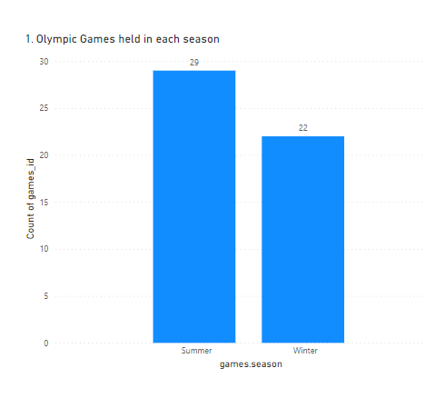
1.How many Olympic Games have been held in each season (Summer vs. Winter)?
1. Here we have to find total no. of Olympic games which were held in Summer session and in Winter Session.
2. After solving this we can see in the graph the results are as following :-
(A) Total games in Summer session = 29
(B) Total games in Winter session = 22

Slide 3
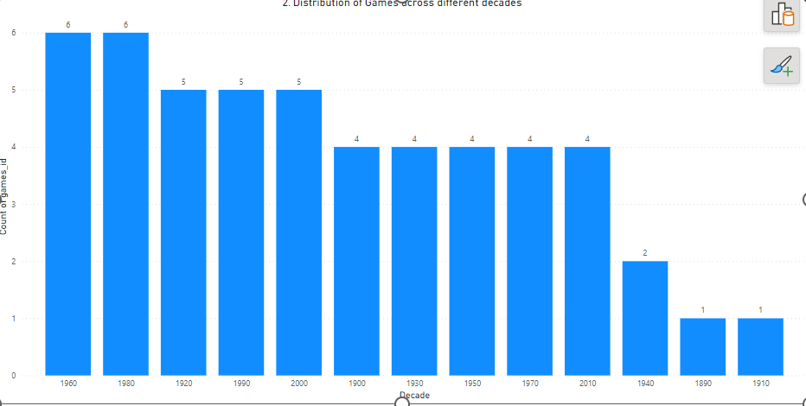
2. What is the distribution of games across different decades?
1. Here we have to find the no. of Olympic games per decade.
2. First we have to need to know which game was held in which decade like if game year was 1952 then it was in 1950’s decade.
3. Then after solving it we can see that in 1960 and 1980 we had most no. of games.

Slide 4
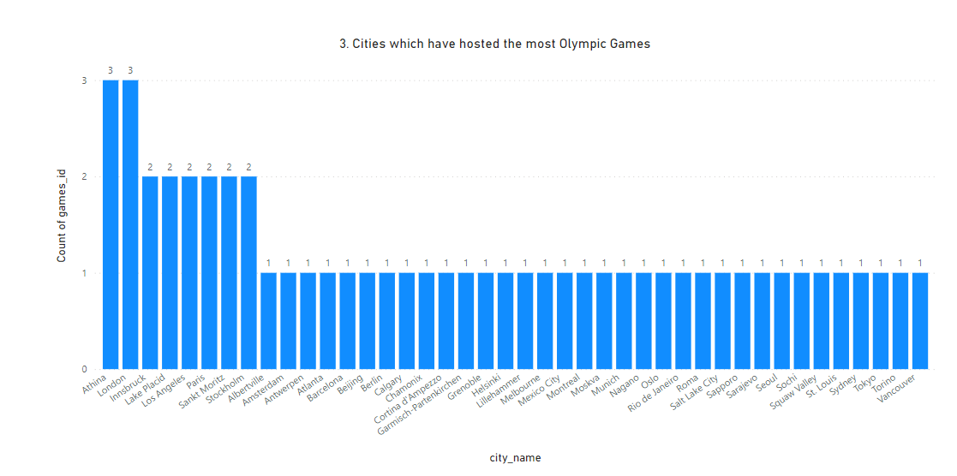
3.Which cities have hosted the most Olympic Games?
Here we have to find the no. of games hosted by cities.
After putting Name of cities in X-axis and count of Game_id in Y-axis we can get this chart.
As we can see in the chart Athina and London had hosted the Olympic game maximum times(3 times).

Slide 5
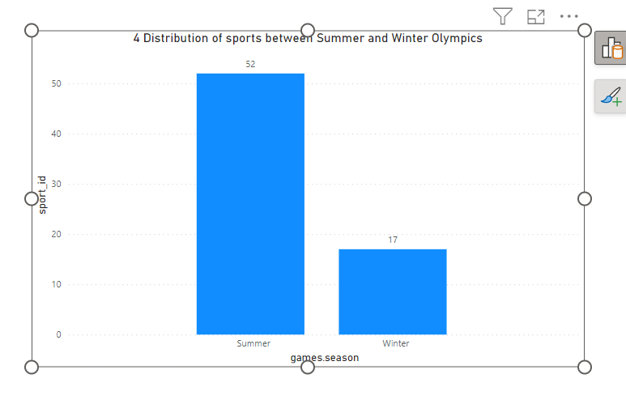
4. What is the distribution of sports between Summer and Winter Olympics?
Here we have to find the no of sports in Summer Olympic and Winter Olympic.
We can get this from putting session in X-axis and count of distinct sport_id in Y-axis.
We can see Summer Olympic(52) have more sports than Winter Olympic(17).

Slide 6
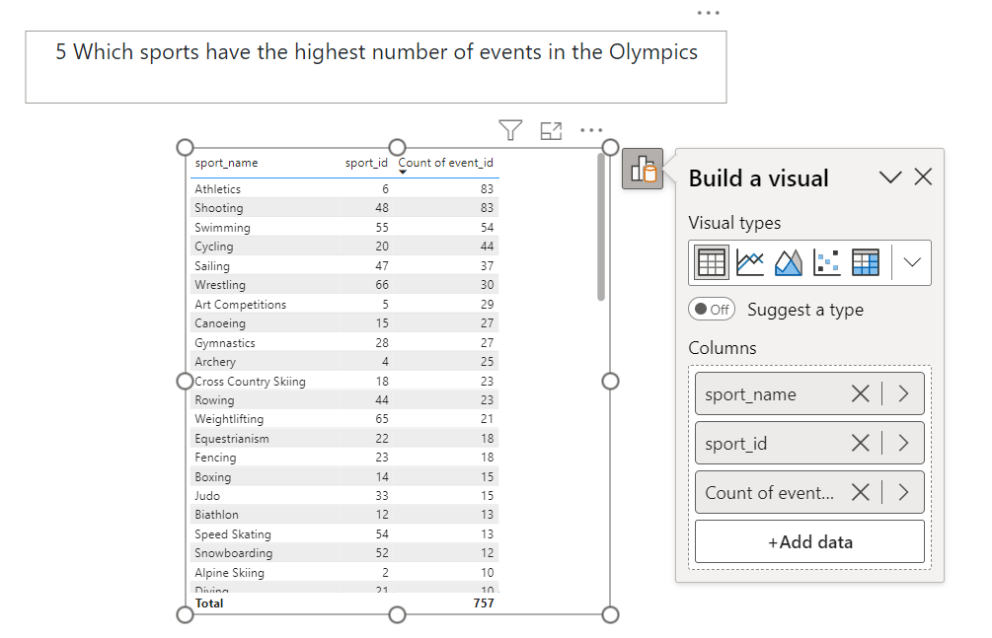
5/7.Which sports have the highest number of events in the Olympics?
Each sports have different no. of events like Athletics have 100mtr,400mtr,800mtr,1600mtr race and many more. So here we have to find the sport which has the maximum no. of events.
As we can see from the table Athletics and shooting had the maximum no of events.
Question no 7 ask for the same output like no of events for each sport.

Slide 7
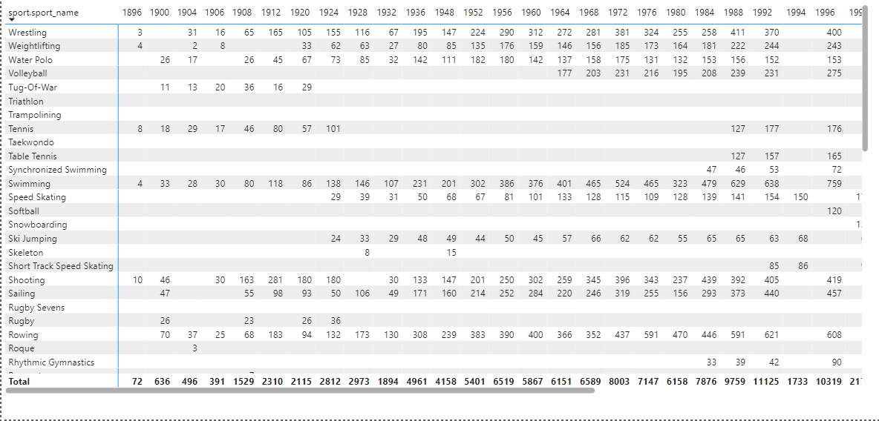
6. How has the participation in each sport evolved over time?
In this question we have to find out the trend of no of participant in each sport in every Olympic game.
We can get this from matrix by putting sport name in rows and year of game in column and count of participant_id in values.

Slide 8
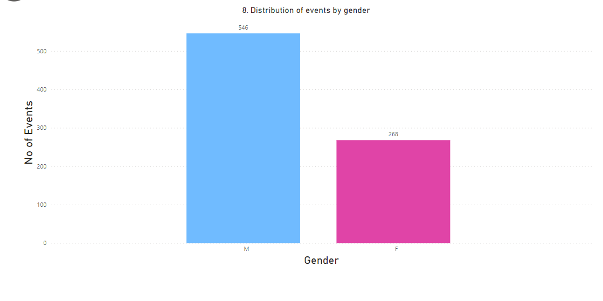
8. What is the distribution of events by gender (Men, Women, Mixed)?
Here we have to find the no of events for each gender.
From the graph we can see males have 546 and females have 268 events in Olympic.

Slide 9
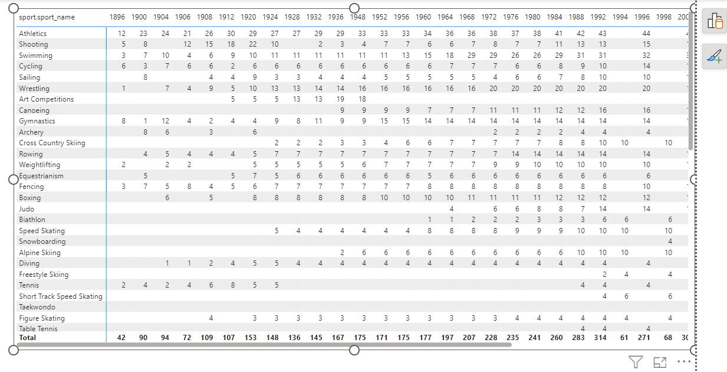
9. How has the number of events changed over time?
Here we have to find the change in no of events in sports time to time.
For short data we can see in 1896 there are total 42 events while in next Olympic which was in 1900 the no of events reached to 90 and so on.
We can also see the change in no of events for every sport.

Slide 10
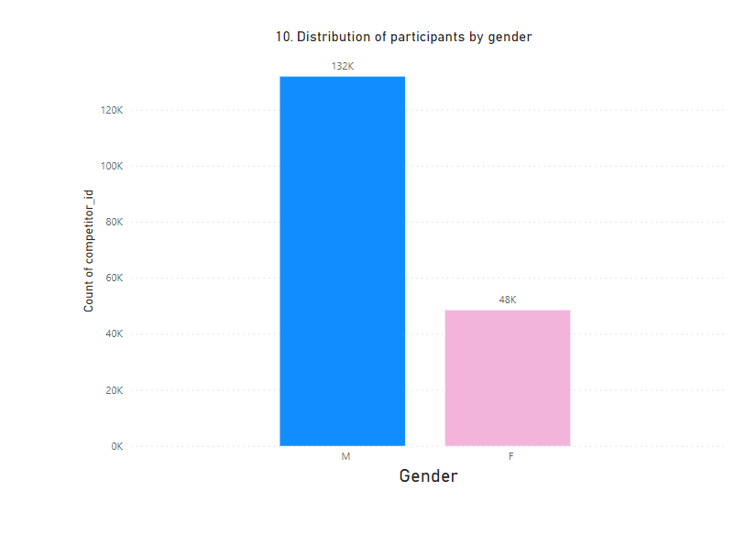
10. What is the distribution of participants by gender?
Here we have to find the no. of participants according to their gender.
So according to our analysis, there have been 132K males and 48K females who have participated in the Olympic so far.

Slide 11
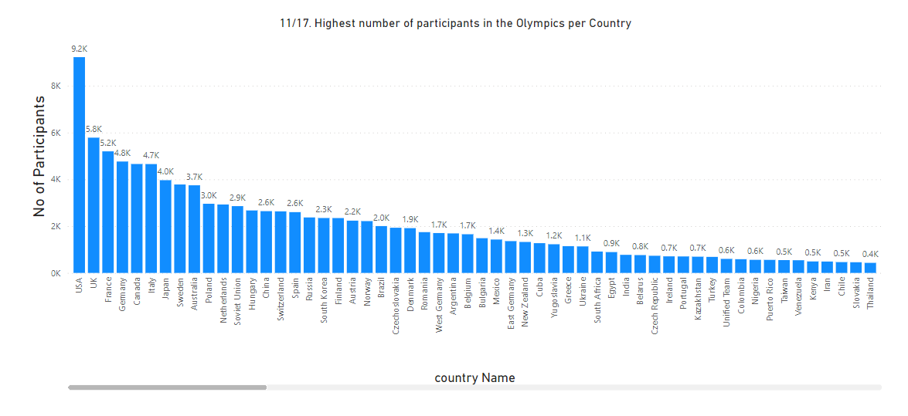
11/17. Which countries have the highest number of participants in the Olympics?
Here we have to find the country with the highest no. of participants.
After our analysis we can see the no. of participant and their Country with their rank.
As we see USA has the maximum no. of participant (9.2K) and UK is on the second position with 5.8K participants.
We have to do the same analysis for question no. 17.

Slide 12
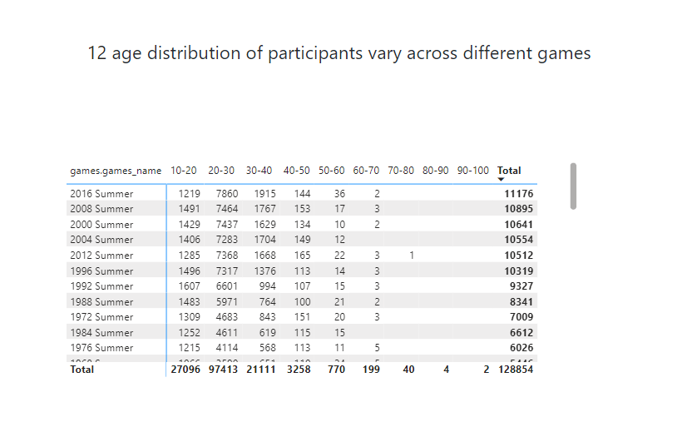
12. How does the age distribution of participants vary across different games?
Here we have to differentiate all the participants according to their age group like if the age of a participant is 24 then he/she will be count in age group 20-30.
For this first we have to add a column which describe their age group.
Now after analysing the data it appears that as the age group is increasing, the no. of participants in that age group decreases in all the Games.

Slide 13
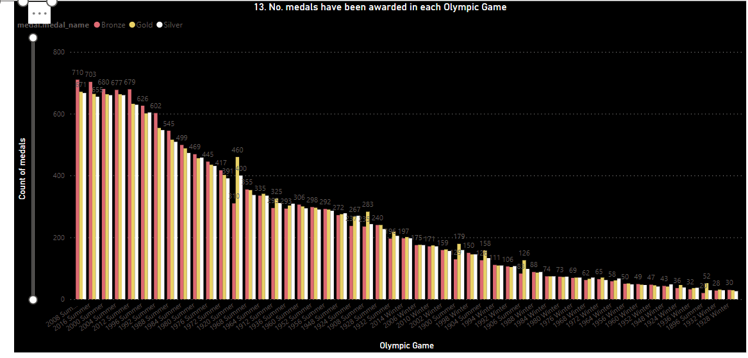
13. How many medals have been awarded in each Olympics?
After analysing this we can say maximum no of medals distributed in games were as following :-
Gold Medal – 2008 Summer Olympic (671)
Silver Medal – 2008 Summer Olympic (667)
Bronze medal – 2008 Summer Olympic (710)
2. Even if we count all the medals then we also get to know that maximum no of medals were distributed in 2008 Summer Olympic games(2048).

Slide 14
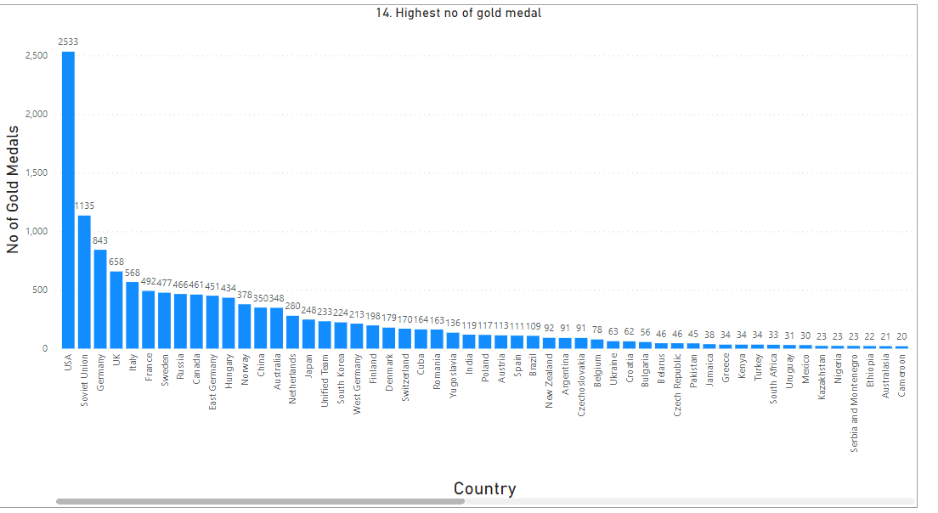
14. Which countries have the highest number of gold medals?
Here we have to count the no. of gold medals won by each country so far.
After analysing the data we get it that USA has won the maximum no. of gold medals(2533).
Soviet Union is on the second no with 1135 gold medals and Germany is on the third rank with 843 gold medals so far.

Slide 15
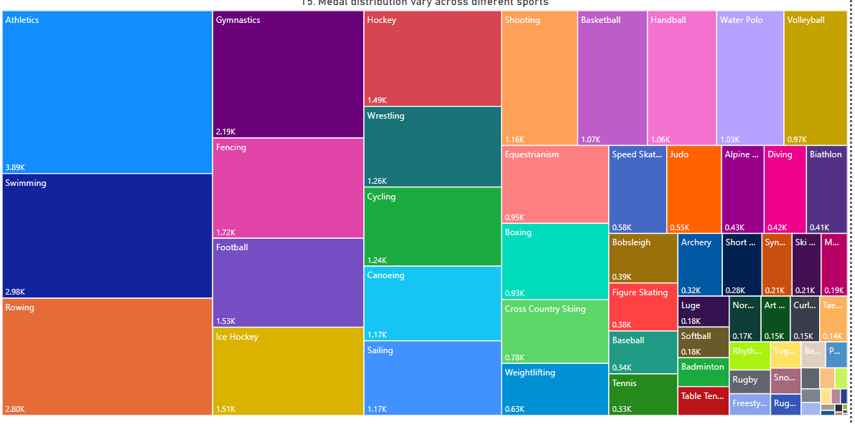
15. How does the medal distribution vary across different sports?
Here we have to find the total no of all the medals which have been distributed in their game category.
After analysing data as we see in the tree map maximum no of medals (gold + silver + bronze) were given in Athletics(3.89K)
Swimming is on the second no with 2.98K and Rowing is on the third rank with 2.80K medals.
We can also find out maximum no of gold medal, silver medal or bronze medal if we wants to.

Slide 16
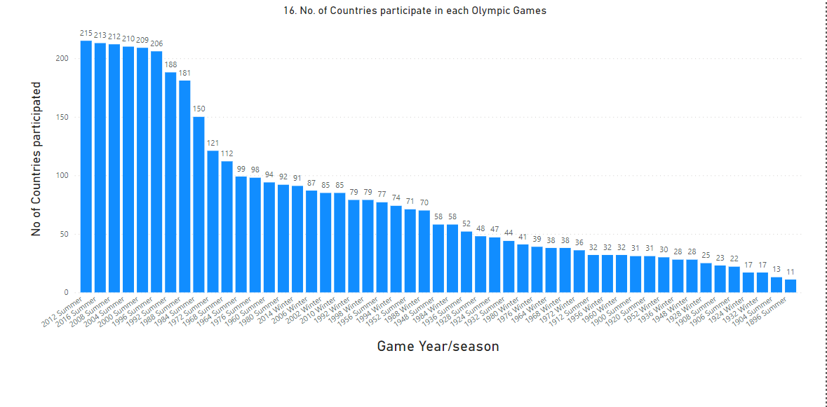
16. How many regions or NOCs participate in each Olympic Games?
In this problem we have to find out the total no. of region/NOC which have participated in games.
After analysing the data we get to that maximum no. of countries which is 215 countries have participated in 2012 summer Olympic game.
After that 213 countries have participated in 2016 summer Olympic.
We also get to know that in 1896 summer Olympic their were only 11 countries who had participated which is the minimum no of countries who had participated in any Olympic so far.

Slide 17
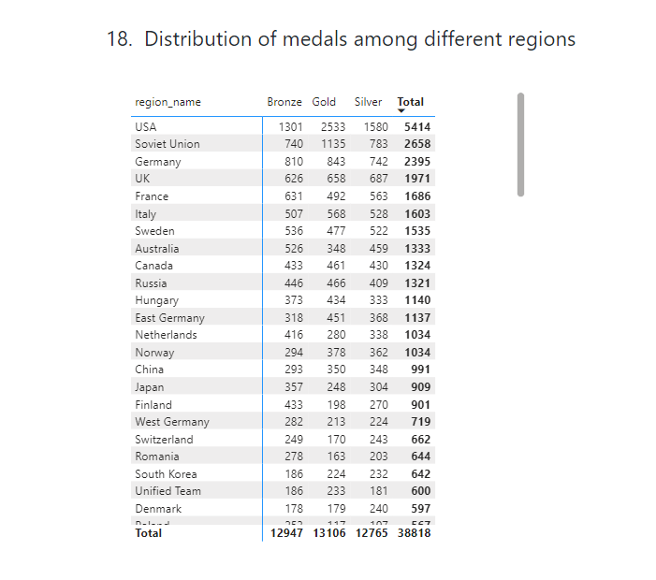
18. What is the distribution of medals among different regions?
In the given problem we have to find all the medals which were given to countries so far.
After analysing the data we can see USA is on the top with 2533 gold, 1580 silver and 1301 bronze medals.
USA is also on the top in all maximum medals.

Slide 18


Slide 19
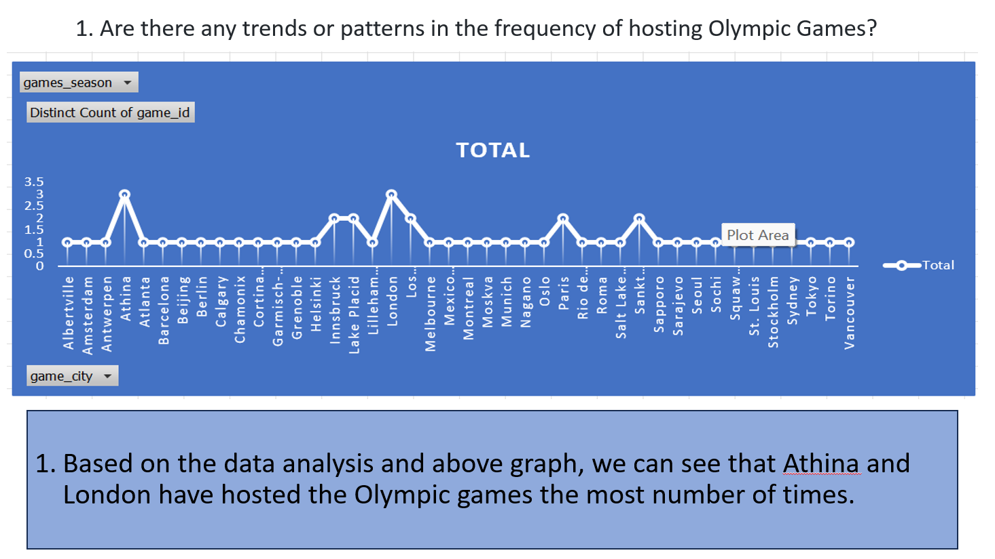

Slide 20
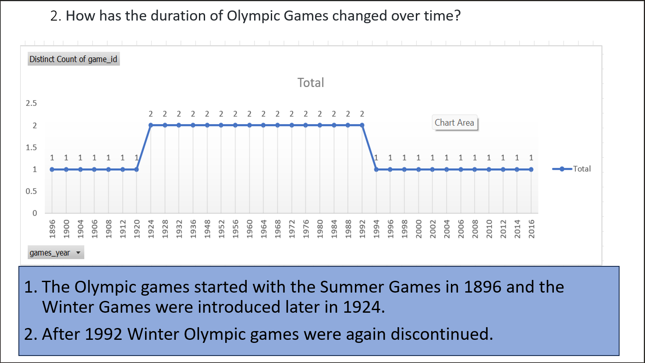

Slide 21
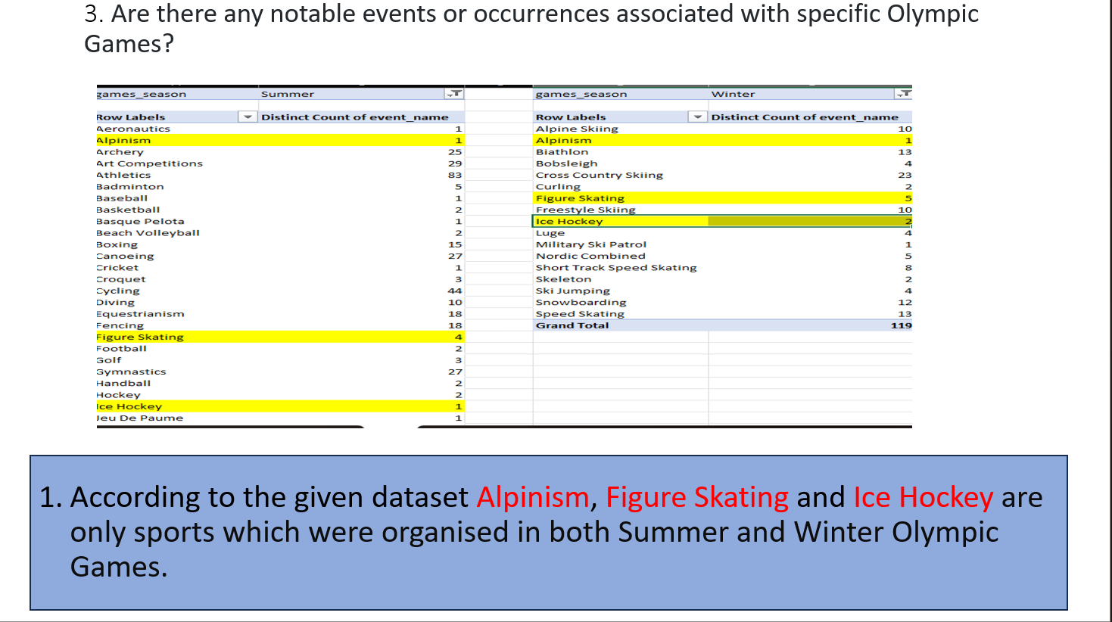

Slide 22
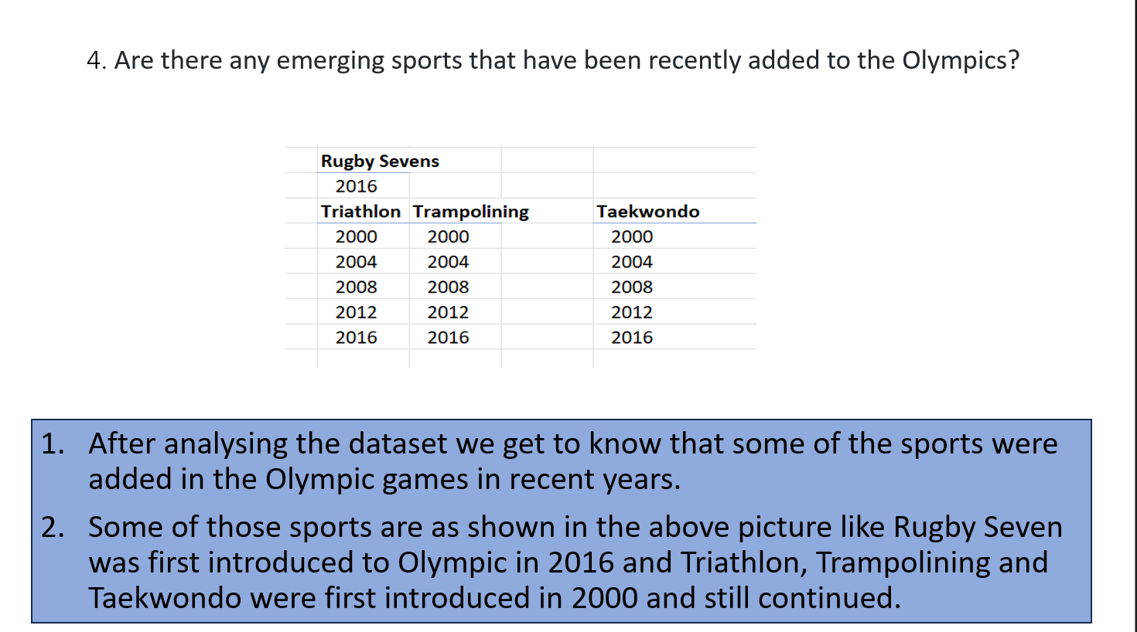

Slide 23
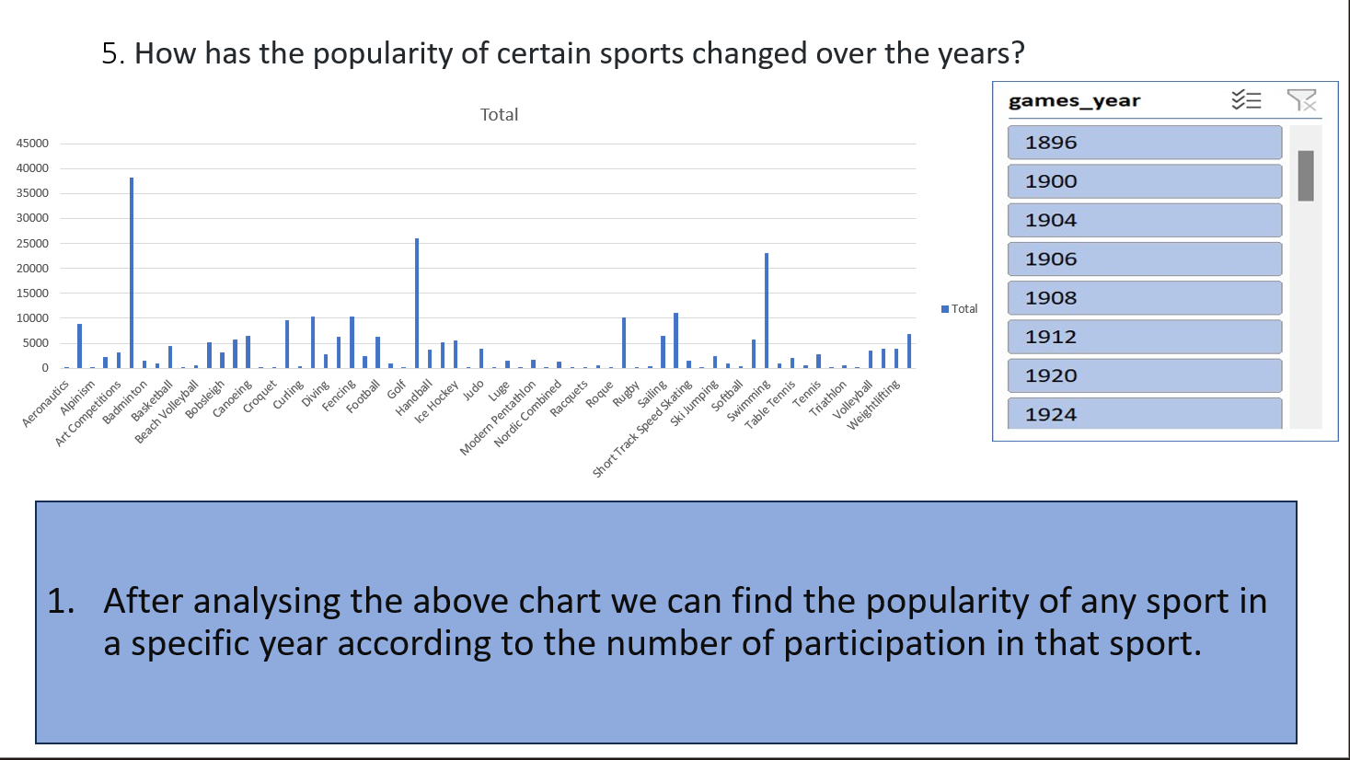

Slide 24
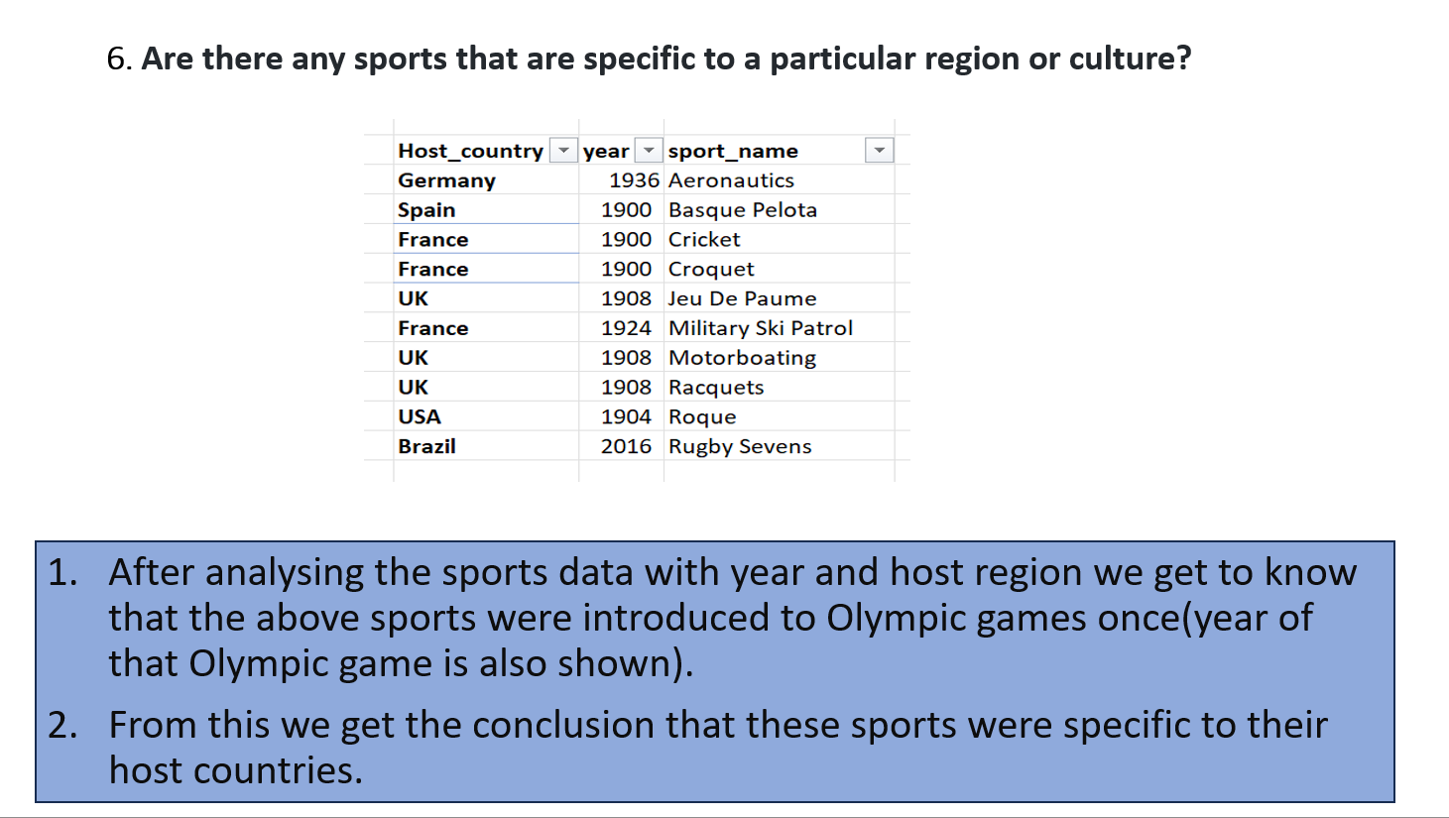

Slide 25
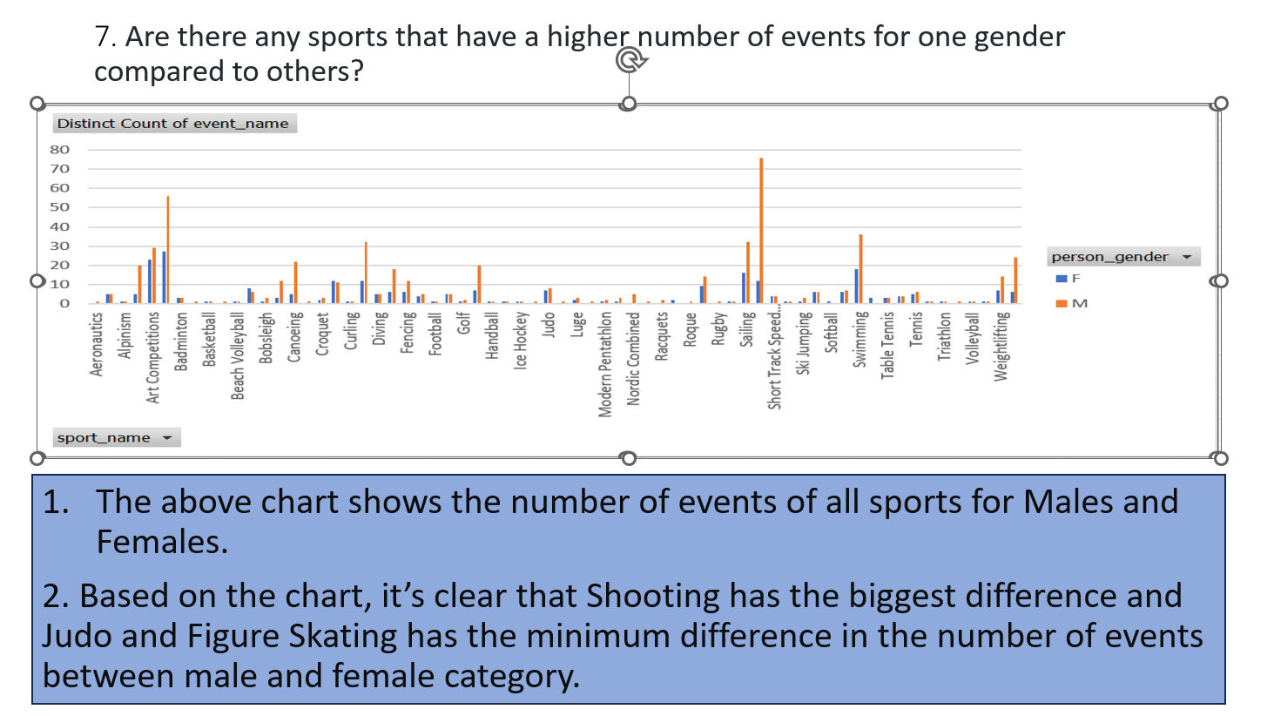

Slide 26
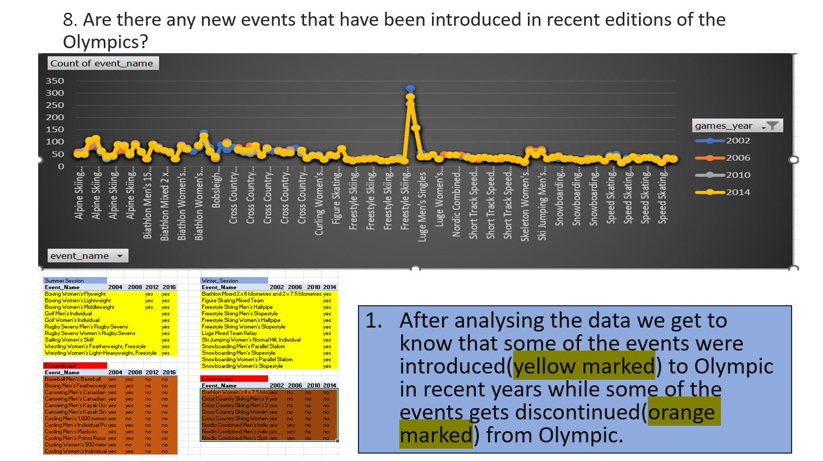
9. Are there any events that have been discontinued or removed from the Olympics?

Slide 27
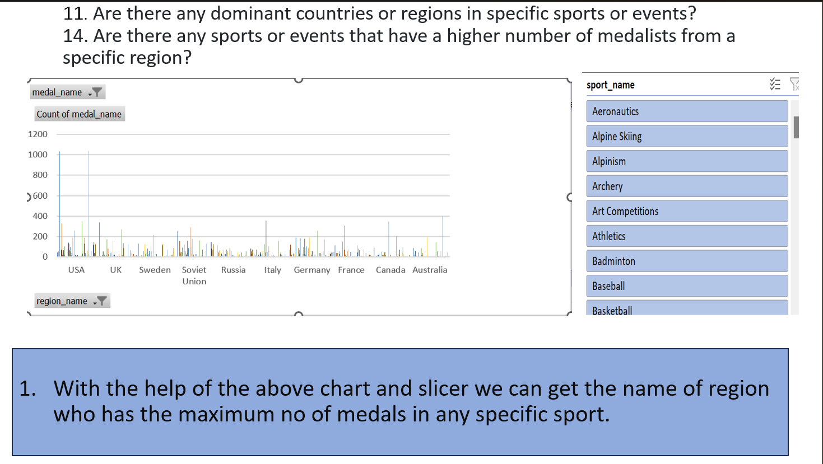

Slide 28
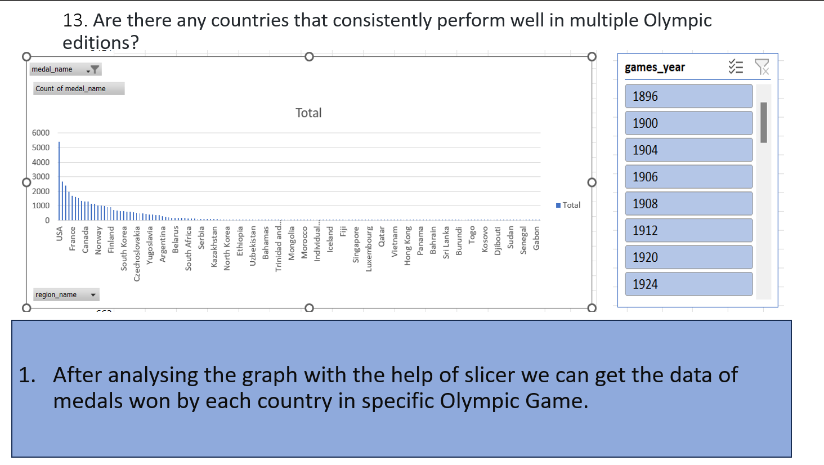

Slide 29
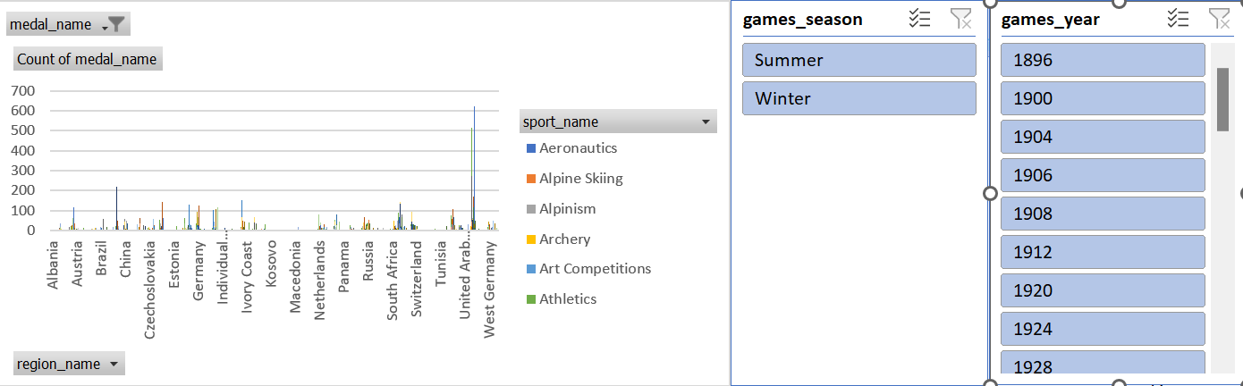
15. What are some notable instances of unexpected or surprising medal wins?
1. When we look at the chart of winning medals year by year, we can spot unexpected victories. For example, if a country goes through several games without winning any medals and then suddenly wins one, we can call it an unexpected win.
2. One of many like this is when USA won in 1980 in Ice Hockey.

Slide 30
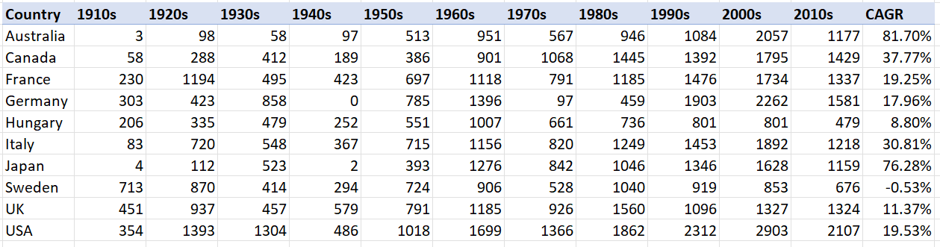
16. Are there any regions that have experienced significant growth or decline in Olympic participation?
1.In the Olympic games , we’ve seen some countries have experienced a significant growth in their participation numbers, while others have seen a decline.
2. Like Australia in the Olympic games have seen a massive growth over the decades. From having 3 participants in the 1910s, the no. has increased to 1177 in 2010s.
3. On the other side Sweden have 713 participant in 1910s which is a good number but it declines to 294 in 1940s and then 676 in 2010s, which means it have seen sometime growth and sometime decline in participation no. but if we see CAGR then Sweden have seen a decline in overall.

Slide 31
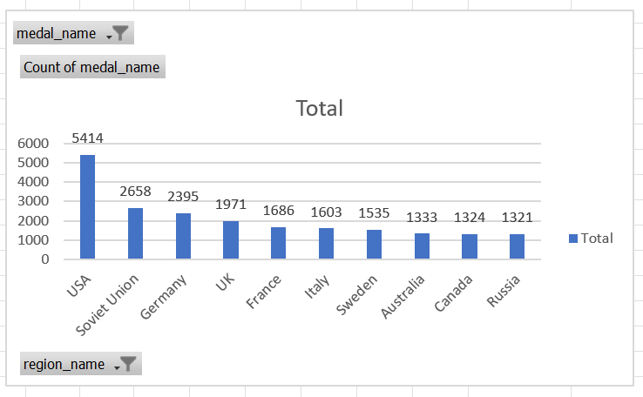
18. Are there any regions that have had a notable impact on the overall medal tally?
1. USA (with 5414 medals) have notable impact on overall medal tally as USA has the maximum medals then any other countries.

Slide 32
Insufficient data for some questions.
10. Are there any notable trends in the height and weight of participants over time?
:- A lots of data was missing from the dataset about height and weight. So we can’t able to analysis that notable trends in height and weight of participants over time.
12. What factors contribute to the success or performance of participants from different countries?
:- Due to insufficient data we can’t able to answer this question just from the dataset. But we can say that due to hill areas and lower temp. European countries have performed well in winter games as there are mostly snow sports like skiing , ice skating etc. in Winter Olympics.
17. How do cultural or geographical factors influence the performance of regions in specific sports?
:- Due to insufficient data we can’t able to answer this question just from the dataset. But we can say that due to hill areas and lower temp. European countries have performed well in winter games as there are mostly snow sports like skiing , ice skating etc. in Winter Olympics.

